Slide 1
Trusses
Dr. Jacob Moore
Associate Professor of Engineering
Penn State Mont Alto

Slide 2
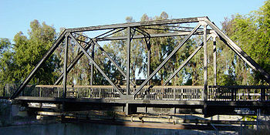
Trusses
A truss is a type of engineering structure where all the members in the structure are two force members.

Slide 3
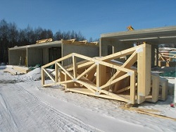
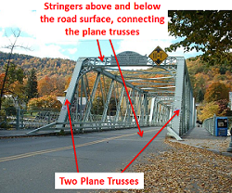
Plane and Space Trusses
Trusses can further be broken down into plane trusses and space trusses.
A plane truss is a truss that exists entirely in one plane.
This means that we will analyze these trusses as 2D systems.
Sometimes we can approximate parts of 3D truss structures as plane trusses.

Slide 4
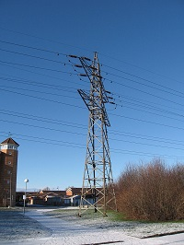
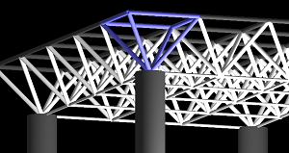
Plane and Space Trusses
A space truss is a truss that does not lie in a single plane.
This means that we will analyze these trusses as fully 3D systems.

Slide 5
What Are We Looking For?
When analyzing any structure, we are trying to determine the forces acting on each individual member in the structure.
If each member is a two-force member, we need to find the magnitude of the force and whether the member is in tension or compression.

Slide 6
Methods for Analyzing Trusses
When analyzing either plane trusses or space trusses, we generally use one of two methods.
The method of joints focuses on the connection points where the members come together (the joints)
It is generally the fastest way to solve for all unknown forces.
The method of sections involves theoretically cutting the truss into multiple sections and then analyzing each individual section.
It is generally the fastest way to solve for the forces in a specific targeted member.
We can also use a hybrid of the method of joints and method of sections.

Slide 7
Thanks for Watching
See other engineering mechanics videos and access the full tool at…

